Slide 1
Subject : Object Oriented Software Engineering
Chapter 1
RUP
Dr. Ashwni Brahme

Slide 2
RUP
RUP is based on a set of six key principles for business-driven development :
(a) Adapt the process
(b) Balance stakeholder priorities
(c) Collaborate across teams
(d) Demonstrate value iteratively
(e) Elevate the level of abstraction
Focus continuously on quality
four major phases of RUP are as follows :
(1) Inception
(2) Elaboration
(3) Construction
(4) Transition

Slide 3
RUP
The core process workflows are divided into six core “engineering” workflows:
1. Business modeling workflow
2. Requirements workflow
3. Analysis & Design workflow
4. Implementation workflow
5. Test workflow
6. Deployment workflow
three core “supporting” workflows:
1. Project Management workflow
2. Configuration and Change Management workflow
3. Environment workflow

Slide 4
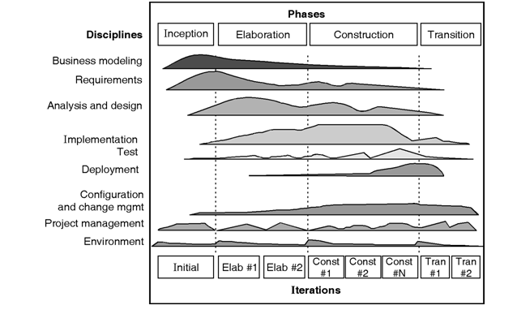
Rational Unified Process

Slide 5
Objective Questions
RUP stands for ------
Rational Unified Process 2. Rational Unit Process
3. Relational Unified Process 4. none of the above
RUP contains --- number of Engineering Disciplines
1. 4 2. 6 3. 7 4. 3
Which of the following are the phases of the unified process
Inception, Analysis, Construction, Implementation
Initiation, Elaboration, Construction, Implementation
Inception, Elaboration, Construction, Transition
Initiation, Analysis Construction, Transition

Slide 6
Objective Questions
In ----- phase of the "RUP Process“ the software accepted by the end users.
1. Transition 2. Inception 3. Elaboration 4. Construction
In which phase of RUP is the "business case" for the project established? 1. Inception 2. Elaboration 3. Construction 4. Transition
The 2 levels of the RUP process are
1. Discipline level 2. Workflow level
3. both 1 and 2 4. none of the above

Slide 7
References
Books
A book "Rational Unified Process — An Introduction", by Philippe Kruchten, published by Addison- Wesley.
Websites
https://www.ibm.com/developerworks/rational/library/content/03July/1000/1251/1251_bestpractices_TP026B.pdf
http://www.admiraalit.nl/rup/doc/LearningRUP7.pdf
https://en.wikipedia.org/wiki/Rational_Unified_Process

